Slide 1
Using periodic simulations to improve compressed air system efficiency 23 September 2016
Name : Brandon Friedenstein
Study leader : Dr Johann van Rensburg
Mentor : Philip Maré
Degree : M.Eng.(Electrical and Electronic)
Purpose : Colloquium

Slide 2
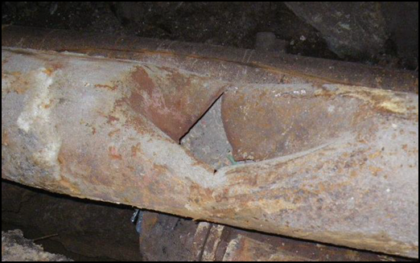
Introduction - background
Mining industry
Simulation
Locate and identify inefficiencies in systems
Require energy cost savings
10% of mine’s total energy usage [1]
Identifying operational inefficiencies can result in significant savings.
Ability to model mine compressed air systems
The optimal operation can be determined using simulation
Quantify savings of operational changes
Mine compressed air systems
Most compressed air systems inefficient [2]
[1] R. Saidur, N. A. Rahim, 2010
[2] J.H Marais, 2012
Notes:
Introduce reader to the context and scope of the proposed study (focus of the study).
Keep it short and to the point.

Slide 3
Introduction - state of the art
Analysis of instrumentation measurements [3]
Identification of energy saving opportunities on cooling systems using simulation [4]
Identifying DSM opportunities on mining operations [5]
[3] C.J.R Kriel, 2014
[4] A.M. Holman, 2014
[5] H.G. Brand, 2014
Notes:
Short summary of what others have done/found with regards to your topic.
Justification and possible conclusions derived from previous studies.
Motivation for the research (why is this research worth doing?).

Slide 4
Introduction - need for the study
Manual methods are cumbersome
To use simulation to identify inefficiencies and improvements on mine compressed air systems
Notes:
Problem statement synthesized for the proposed study
This must be short and “punchy”.

Slide 5
Development of solution
Investigate
Compile simulation
Analyse results
Obtain data
Test model accuracy
Implement
Identify inefficiencies
Verify using first principles
Validate
Case studies
Quantify financial benefit
Continuous system improvement
Prioritise interventions
Assumptions
Determine ideal operation
Verify Simulation
Periodic simulations
Create model
Baseline operation (specific to mine)
Review
Notes:
How are you going to create your solution (methods used)?
How will you design your solution.
Data collection techniques and instruments.
Data analysis strategies and testing.
What do you think will the end product be?

Slide 6
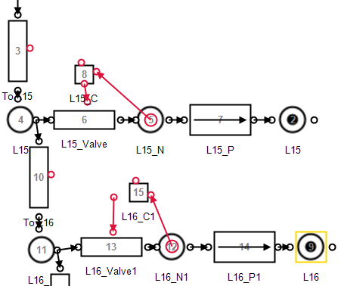
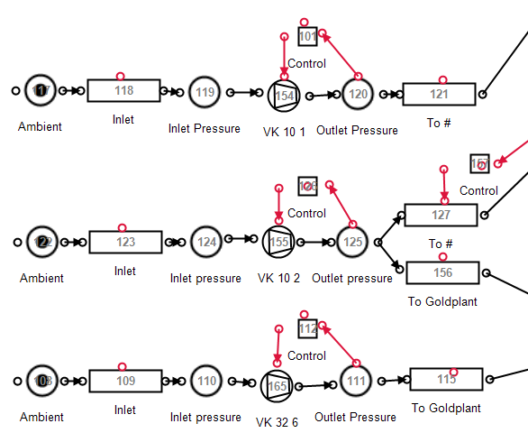
Expected results
Streamlined identification process
Savings on typical mine compressed air:
Network of pipes
Compressors
Notes:
Expected or actual results.
Must give figures/graphs/tables/values.
If no results are available, give guestimates.
Explain/interpret the information provided.
Make sure graphs have legends and that units are indicated.

Slide 7
Expected results
Energy demand saving: 0.29 MW EE
Financial saving: R1.6 million p.a.
Other interventions identified:
Compressor selection 1 MW
Pressure set point improvements 0.2 MW
Notes:
Expected or actual results.
Must give figures/graphs/tables/values.
If no results are available, give guestimates.
Explain/interpret the information provided.
Make sure graphs have legends and that units are indicated.

Slide 8
Proposed timeline
 | 2016 |  | 2017
 | Nov | Dec | Jan | Feb | Mar | Apr | May | Jun | Jul | Aug | Sep | Oct | Nov
Document write up
Chapter 1: Introduction
Chapter 2: Literature study
Chapter 3: Methodology
Chapter 4: Results
Chapter 5: Conclusion
Revision
Proof read
Final submision

Slide 9
Conclusion
Streamlining inefficiency identification can lead to energy savings
Developing an identification methodology
Improved identification and energy savings
Study completion: November 2017

Slide 10
References
[1] R. Saidur, N. A. Rahim, and M. Hasanuzzaman, “A review on compressed-air energy use and energy savings,” Renewable and Sustainable Energy Reviews, 2010
[2] J.H Marais, “An integrated approach to optimise energy consumption of mine compressed air systems”, 2012
[3] C.J.R. Kriel, “Modernising underground compressed air DSM projects to reduce operating costs”, 2014
[4] A.M. Holman, “Benefits of improved performance monitoring of mine cooling systems”, 2014
[5] H.G. Brand, “An integrated sustainability framework for environmental impact reduction in the gold mining industry”, 2014
Notes:
References related to the presentation (required to check referencing format).
Ensure formatting is correct.
Tip:
Use the CRCED PTA Mendeley database from the start. It will save you lots of time.

Slide 11

Questions?
The use of simulations to identify compressed air system inefficiencies 23 September 2016
Study leader : Dr Johann van Rensberg
Mentor : Philip Maré
Degree : B.Eng. (Electrical and Electronic)

